Slide 1
The New healthcare Consumerism
Brainstorming with
Jane Sarasohn-Kahn, MA (Econ.), MHSa
Think-Health LLC & Health populi blog
17 November 2023
1

Slide 2
The New healthcare Consumerism our roadmap
Tracking the journey from patient to consumer
Heath @ Retail – a trip from Florence, Italy to Main Street, USA
The evolving retail health map (hint: don’t blink!)
The retail health mindset and landscape – future drivers and prospects
Brainstorming…

Slide 3
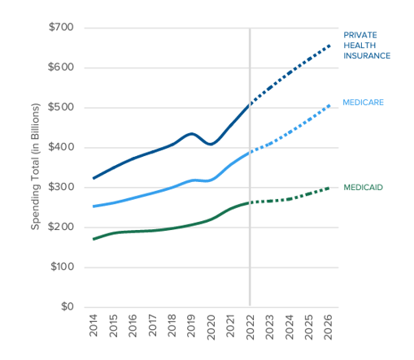
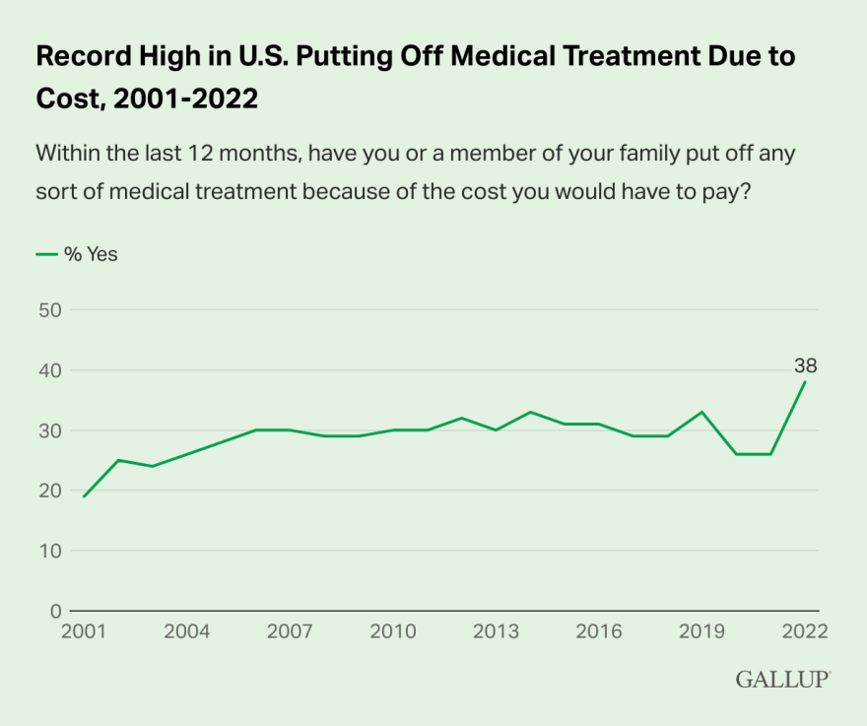
Unaffordability suppresses demand for health care, including prescription drugs
Sources: Centers for Medicare and Medicaid Services (CMS), National Health Expenditures, 2019-2028;
Record High in U.S. Put Off Medical Care Due to Cost in 2022, Gallup, January 17, 2023

Slide 4
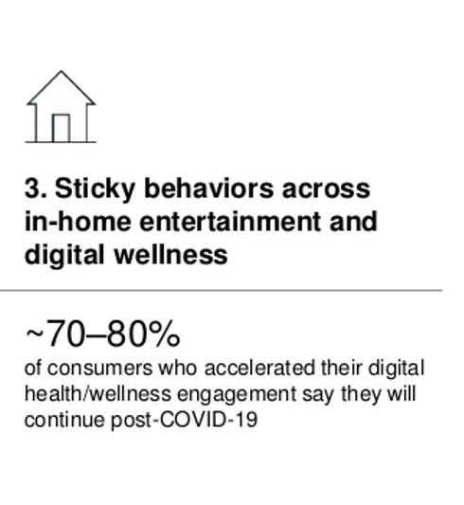
DIY healthcare in the pandemic → Radical Self-Care Covid-19 accelerated consumers’ self-care trends
Sources: Adapted from Radical Self-Care and the Changing Store Environment, Kantar, September
21, 2020; US consumer sentiment during the coronavirus crisis, McKinsey, March 24, 2021
Notes:
Another DIY life-flow for people was taking on more self-care and really more radical self care. We saw sales of ancestry and DNA kits increase in 2020, more attention to vitamins minerals and supplements to address immunity and brain health, and sleep as medicine…also greater attention to connected fitness and wearable technology….

Slide 5
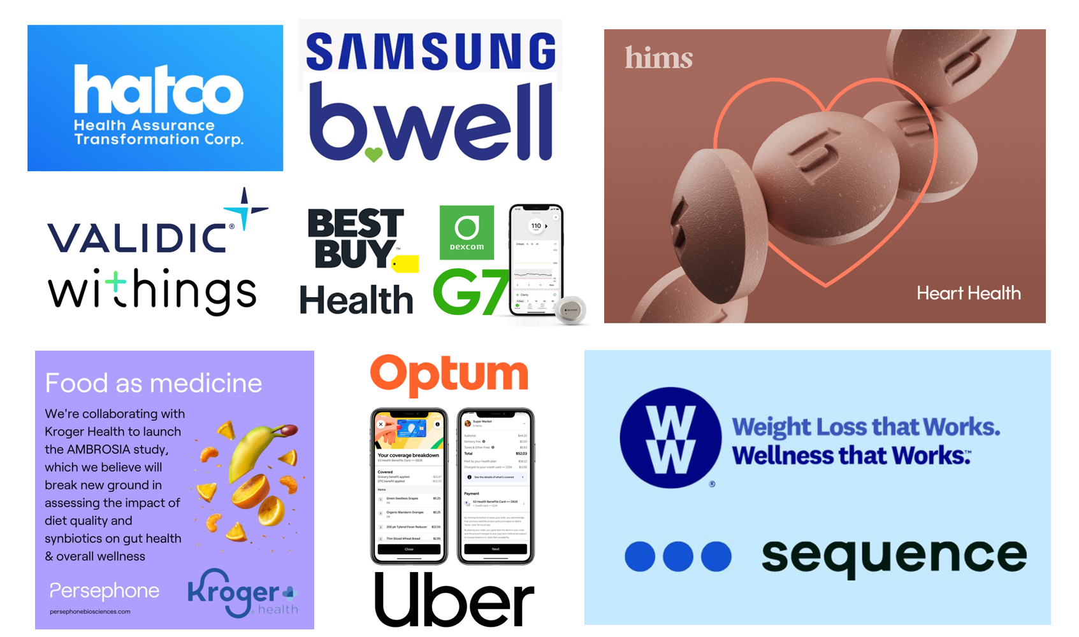
One week of retail health news in October 2023 (don’t blink!)
5

Slide 6
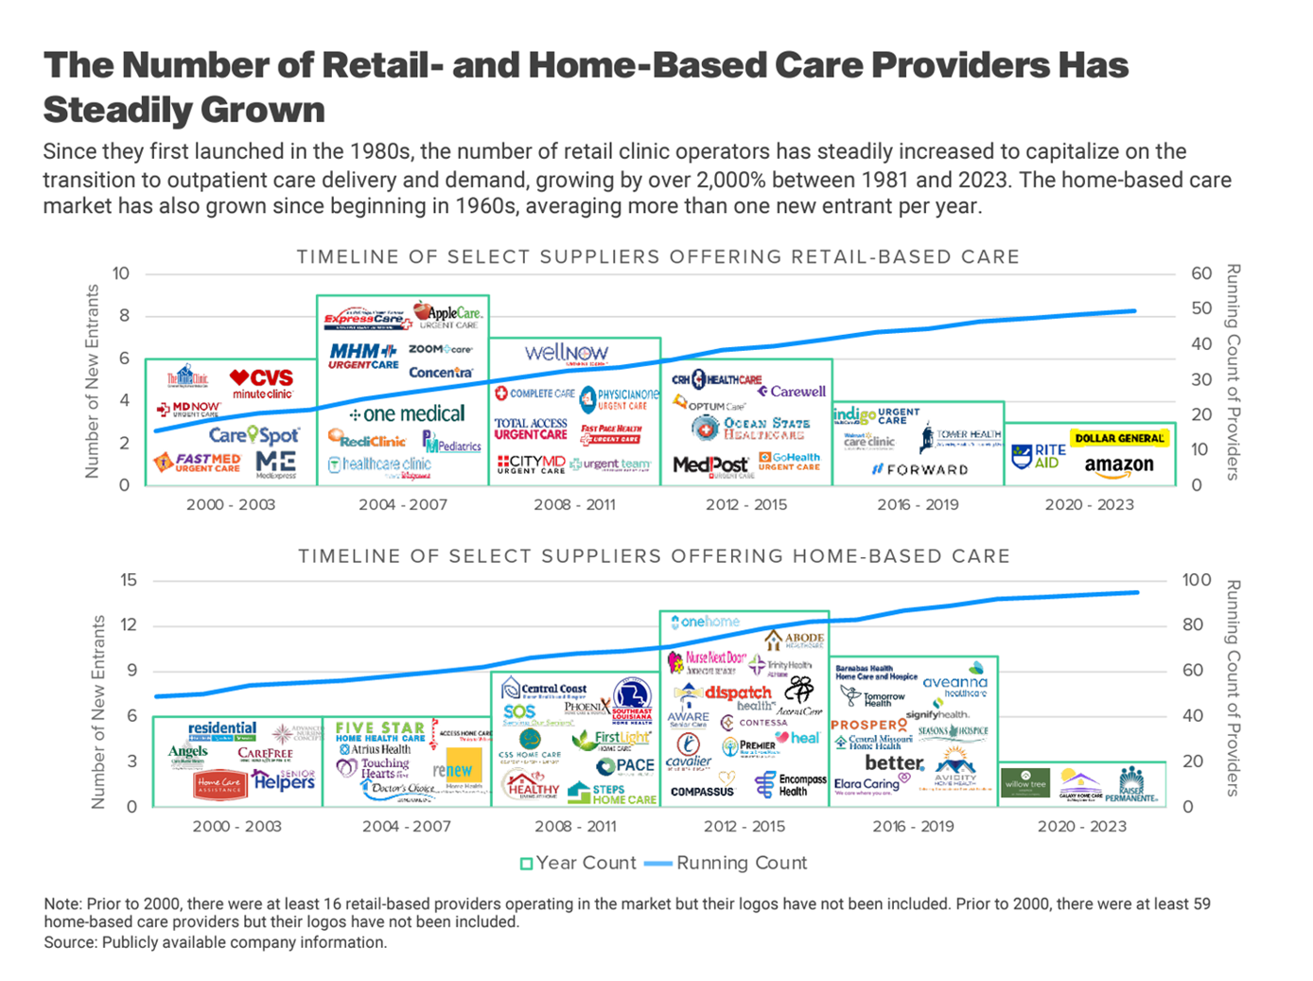
6

Slide 7
The New healthcare Consumerism future drivers and prospects
Consider macroeconomics – future of Medicare, Medicaid, Social Security
Consider microeconomics of the household, by generation
Demand for self-care vs. a primary care medical home (watch Millennials, Gen Z)
Track growth of value-based payment among providers
Track supply-side of providers – physicians, nurses, pharmacists – burning out, dropping out, re-purposing their human capital
Monitor clinical evidence for wearable tech, RHM, digital tx
Some Big Questions to ponder…
The Future of Hospitals (and business models)?
Employer-sponsored health insurance?
Impact of social determinants of health on health equity and access?

Slide 8
Jane Sarasohn-Kahn, MA (Econ.), MHSA
Health Economist, Advisor, Trend Weaver
jane@think-health.com
www.healthpopuli.com Blog
@healthythinker
+1 (484) 695-7735

